Slide 1
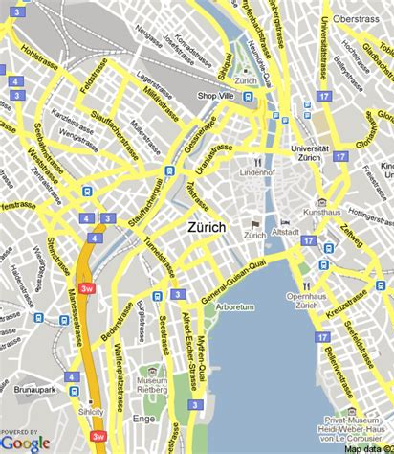
The 15-Minute City in Practice Comparing theoretical accessibility and real mobility patterns in Zurich
Lucie Kern and Noémie Simon
Patterns and Trends in Environmental Data
03.06.2026

Slide 2
Context & Project Intro
What is a 15-minute city ?
🏠 🛒🎓 💼🌳 🍽️ 🚉 🏥
A city where residents can meet most of their everyday needs within a 15-minute walk or bike ride from their home, reducing dependence on cars and improving urban sustainability and quality of life.
Application Area
Conceptual Model
Data
urban planning
mobility analysis
accessibility
We use activity space to compare theoretical accessibility with actual mobility behavior based on the data collected from one individual living in Zurich
Google timeline for individual mobility
OpenStreetMap for road networkt, transport infrastructure for urban context and Point of Interest
Goal
Understand whether accessible infrastructure is actually reflected in everyday mobility behavior
Moreno, C., Allam, Z., Chabaud, D., Gall, C., & Pratlong, F. (2021). Introducing the “15-Minute City”: Sustainability, resilience and place identity in future post-pandemic cities. Smart Cities, 4(1), 93–111. https://doi.org/10.3390/smartcities4010006

Slide 3
1. What share of daily activities occurs within 15 minutes from home ? (per means of transportation)
2. How does actual mobility differ from the theoretical accessibility?
3. Which types of activities most often occur beyond a 15‑minute radius?
Research questions

Slide 4
Research plan
Collection of data of trajectory (google maps)
Creation of isochrones (15-minute accesibility zones)
Detection of point of interests (POI)
Preprocessing of collected data (segmentation, categorization of visited points, mobility shapes)
Join both datasets
Analysis and computation of theoretical accessibility and practical mobility
Results visualisation
Activity Classification Model - ground truth
Eventually add an isochrone with different speed
Processing of the POI (KDE)

Slide 5
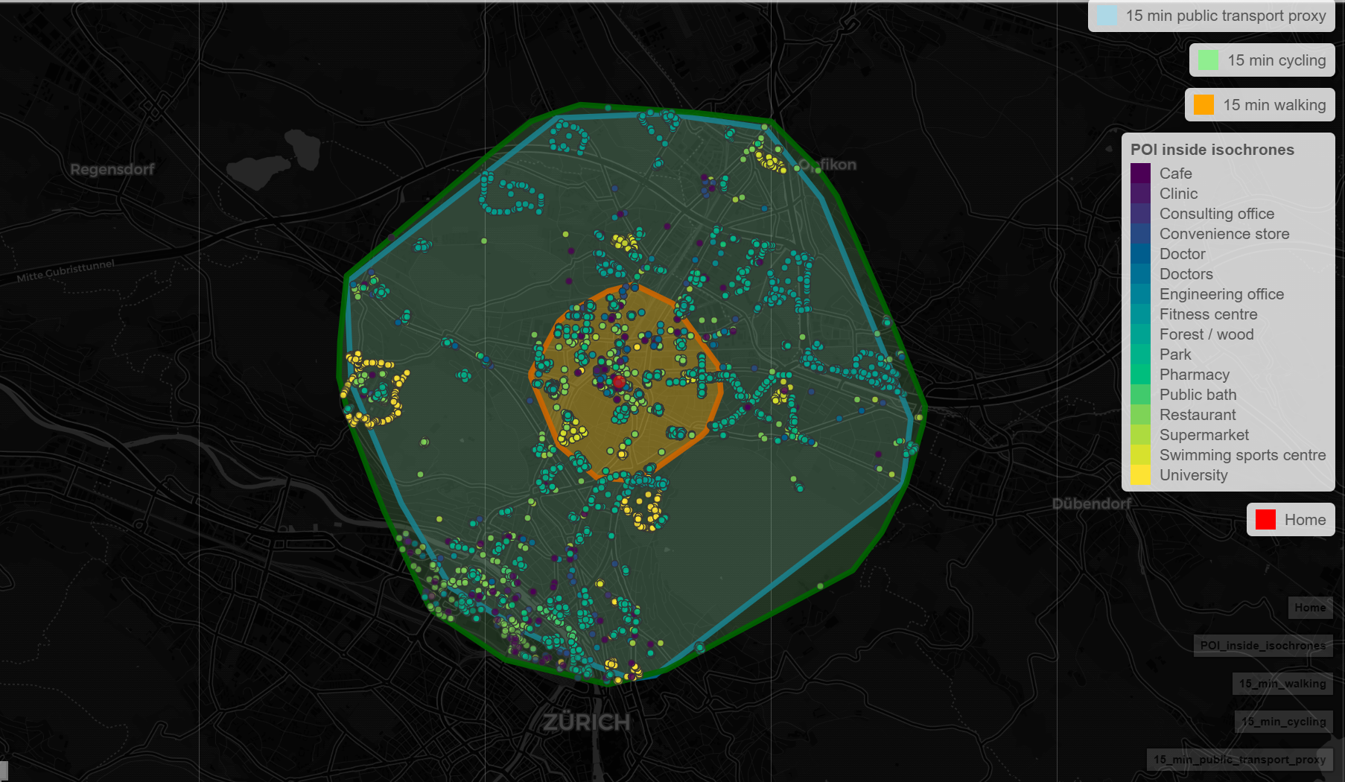

Slide 6
Activity Classification
category | includes
transport | train stations, tram stops, bus stops, airports
home | residence
education | university, school
work | workplace
shopping | supermarket, stores, post office
leisure | restaurants, bars, cinema, culture
sport | gym, climbing, swimming
nature | hikes, parks, mountains
social | friends/family
movement | No POS ( reclassify to movement as record type instead of visit)
healthcare | doctor, pharmacy
unknown | unresolved

Slide 7
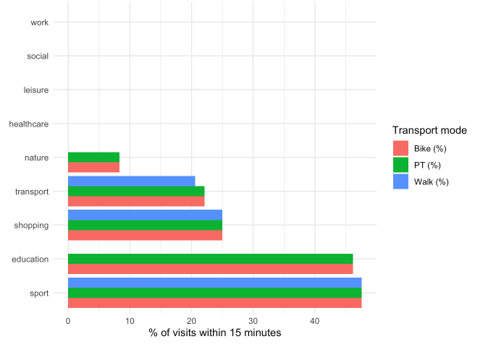
Preliminary results
What proportion of activities occur within 15 minutes?

Slide 8
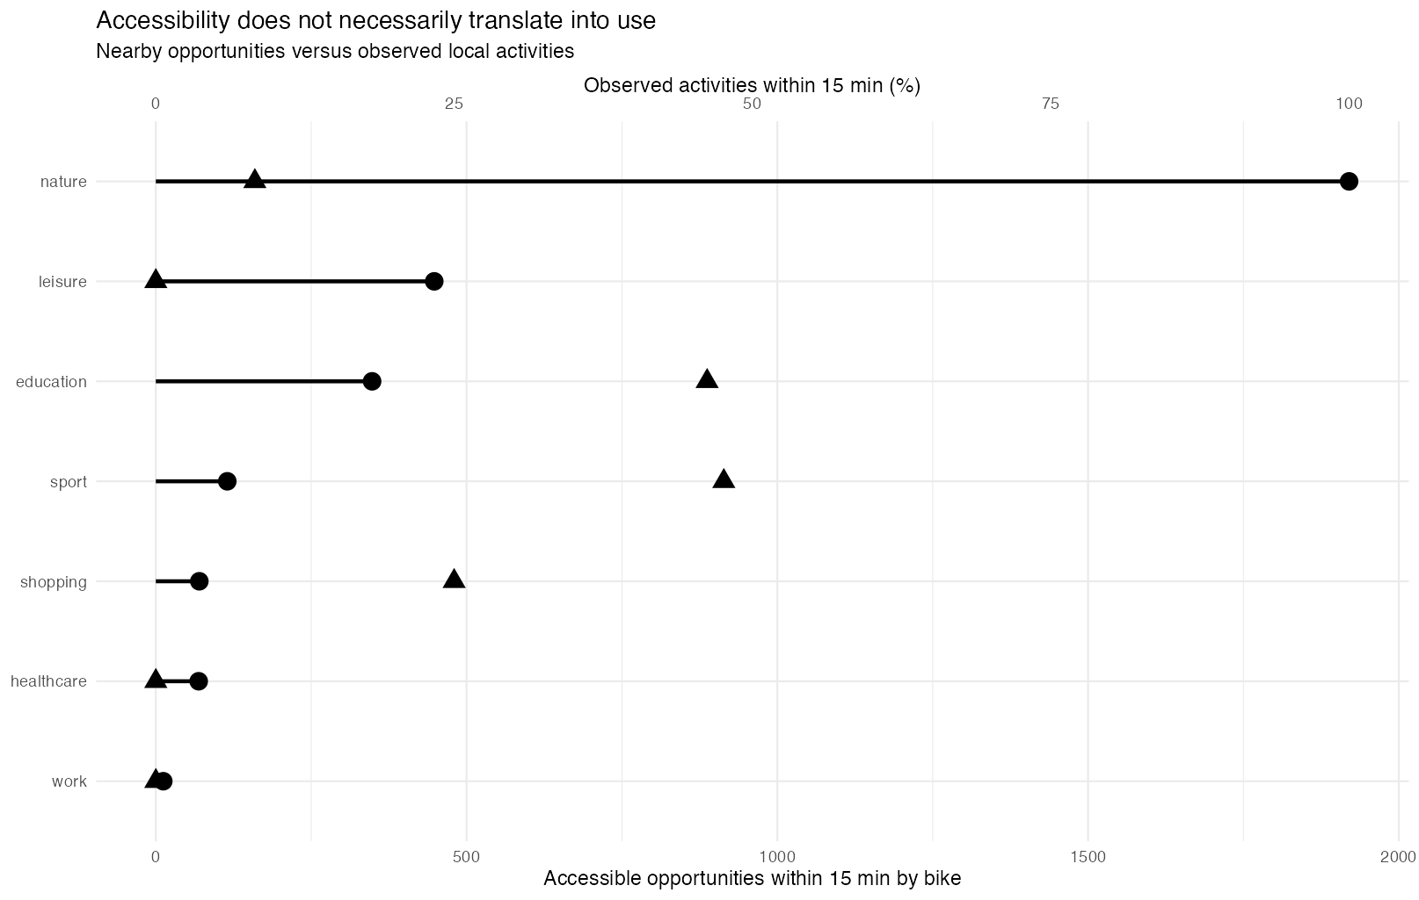
Accessibility Gap
How does actual mobility differ from the theoretical accessibility?

Slide 9
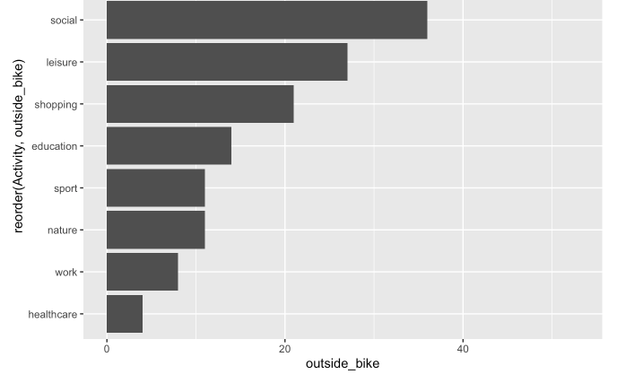
Types of activities occurring beyond the 15-minute city

Slide 10
Challenges and Plan B
Integration of the ZVV time plan
Heavy data set
Add unnecessary complexity
Use an estimation of the speed of the public transports (bus and tram) of 15 km/h
Anonymisation of the data
With only a few visited points, it is possible to find out where the person lives/who they are
Change the adress by a few blocks/streets (but still not ideal)
POI interpretation and accuracy
Difficult to assess how accurate the POI data are, and the data take a long time to load.
→ Need for validation and processing

Slide 11
Context
What is a 15-minute city ?
🏠 🛒🎓 💼🌳 🍽️ 🚉 🏥
A city where residents can meet most of their everyday needs within a 15-minute walk or bike ride from their home, reducing dependence on cars and improving urban sustainability and quality of life.
Application Area
Conceptual Model
Data Structure and Availability
urban planning
mobility analysis
accessibility
Activity Space
Space - Time Prism
Individual Mobility Data
Google timeline
Urban context Data
OpenStreetMap
Moreno, C., Allam, Z., Chabaud, D., Gall, C., & Pratlong, F. (2021). Introducing the “15-Minute City”: Sustainability, resilience and place identity in future post-pandemic cities. Smart Cities, 4(1), 93–111. https://doi.org/10.3390/smartcities4010006

Slide 12
Presentation general of the project
We compare theoretical accessibility with actual mobility behavior
Case study: one individual living in Zurich
Data: Google Timeline GPS trajectories over 3 months
Context data: Points of Interest and transport infrastructure
Main focus: identifying mismatches between:
nearby available services
15-minute accessibility areas
daily travel patterns
Goal: understand whether accessible infrastructure is actually reflected in everyday mobility behavior.

Slide 13
Best Possible Outcome
We expect to:
Quantify the proportion of local vs non-local activities
Identify activity types that exceed the 15-minute threshold
Evaluate whether mobility is driven more by accessibility or by personal preferences and habits
Hypothesis: Even in Zurich, many social and professional activities
occur beyond the theoretically accessible area

